Slide 1

Student Branch Chapter @ USF
Get right with industry certifications
Hardware Lead: Sebastian Pulgar

Slide 2
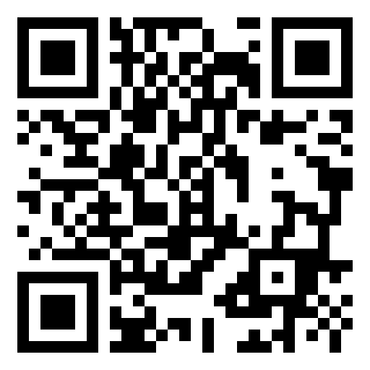
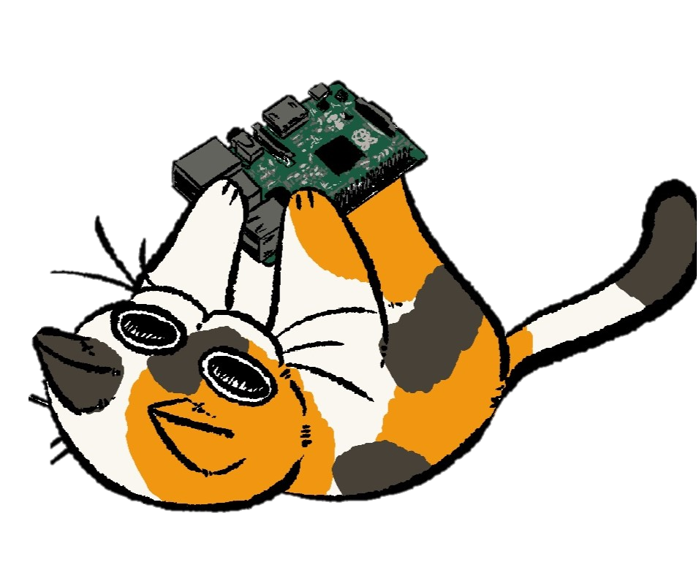
Check in! Support us

Slide 3

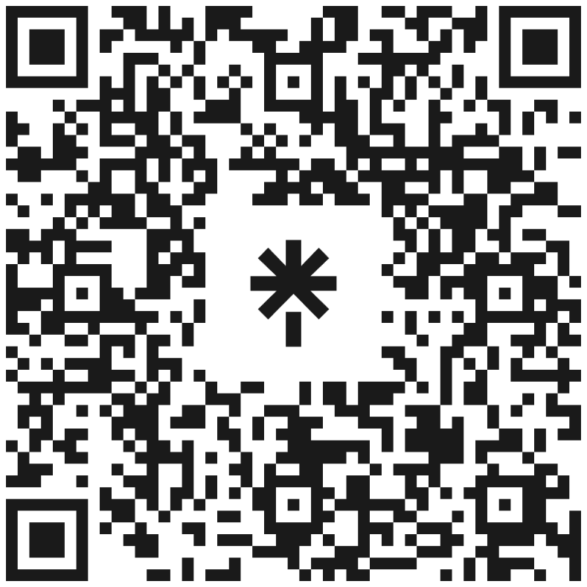
Follow Us
Discord
LinkedIn
Instagram
Bulls Connect
GitHub (We will need that one!!!)

Slide 4

About me :
I am Venezuelan
I love playing basketball
Eating mass amounts of food is my hobby
I believe steak is best cooked on a pan

Slide 5
What we are covering today
What are certifications
Why you should get certifications
ComptTIA
How to study for these certifications
Cloud Computing Certifications
Coding related Certs?
Future events

Slide 6
What are certifications
Certifications are official credentials from companies like Comptia, Amazon, Google, Microsoft, and other major companies.
Aquiring these allows you to stand out among your peers and really put you ahead of others especially in college.
Allows you to prove what you know on your resume

Slide 7
You can land pretty much any job In a computer related field WITH CERTIFICATIONS

Slide 8
CompTIA Certifications

Slide 9
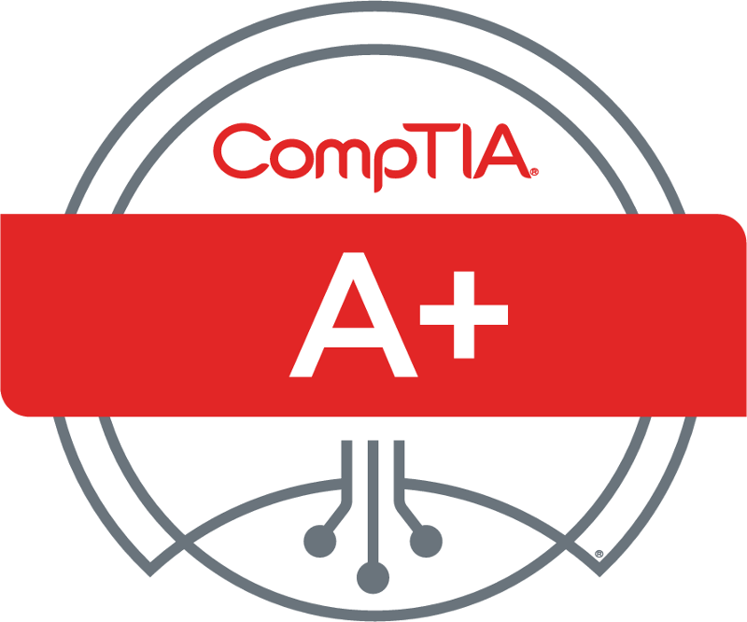
CompTIA A+
Need to do 2 exams to get certified
Duration: 90 minutes
Exam format: 90 questions
Cost: 530$
675 out of 1000 to pass on 1st one, 700 out of 1000 on 2nd one
Topics covered:
  Exam 1 Exam 2
  Mobile devices (15%) Operating Systems (31%)
  Networking (20%) Security (25%)
  Hardware (25%) Software Troubleshooting (22%)
  Virtualization and Cloud Computing (11%) Operational Procedures (22%)
  Hardware and Network Troubleshooting (29%)

Slide 10
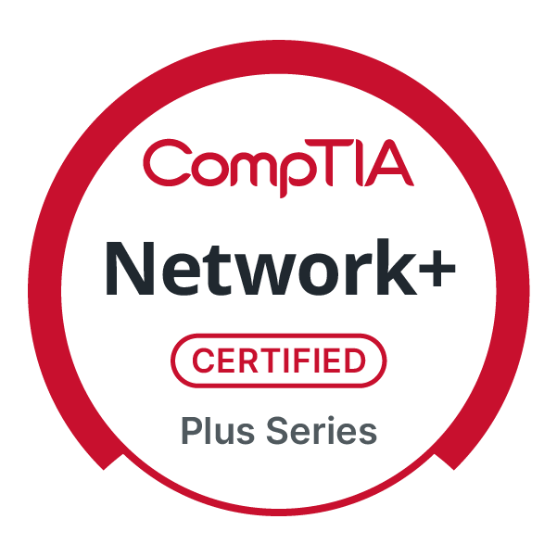
Network+
Only one exam to get certified
Duration: 90 minutes
Exam format: 90 questions
Cost: 390$
720 out of 900 to pass
Exam Objectives
  Networking Concepts (23%)
  Network implementation (20%)
  Network Operations (19%)
  Network Security (14%)
  Network Troubleshooting (24%)

Slide 11
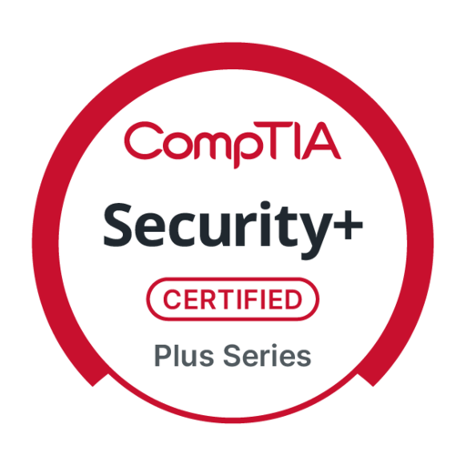
Security+
Only one exam to get certified
Duration: 90 minutes
Exam format: 90 questions
Cost: 425$
750 out of 900 to pass
Exam Objectives
  General Security Concepts (12%)
  Threats, vulnerabilities, and mitigations (22%)
  Security Architecture (18%)
  Security Operations (28%)
  Security program management and oversight(20%)

Slide 12
How to study for CompTIA Certifications
Free options
Professor messer
ChatGPT
Payed Options $
DionTraining
Udemy
Testout Labsim

Slide 13
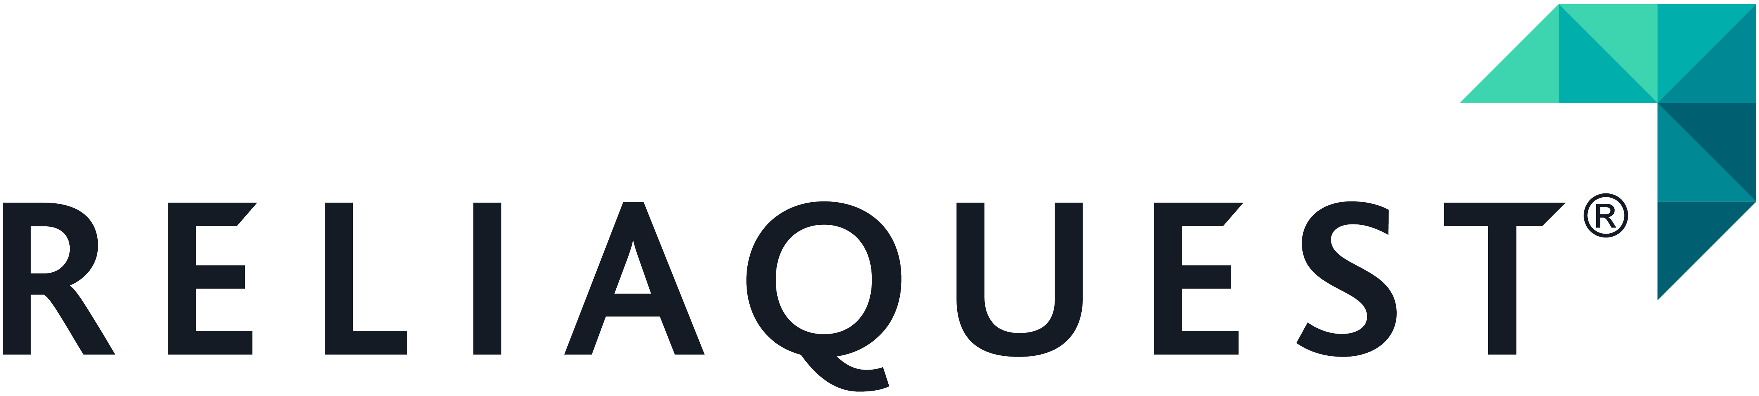
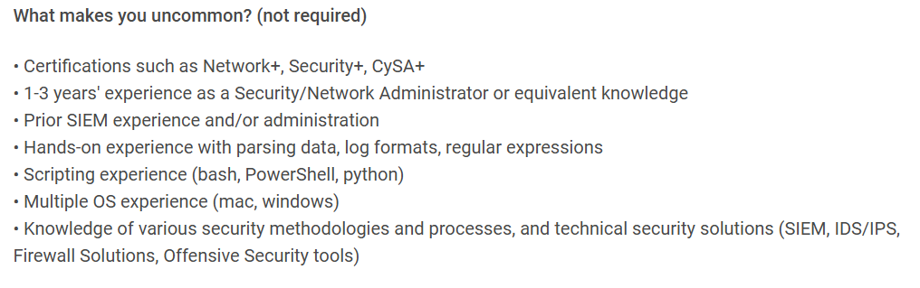

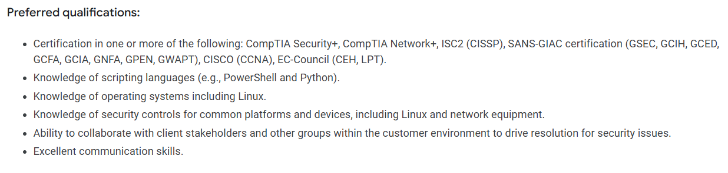






Slide 14
Cloud Computing Certifications

Slide 15
Why should you get AWS Certifications?
Validates that you can design, build, and secure systems on the world’s most widely used cloud platform.
Makes you competitive cloud engineer and cloud security specialist roles
Gives you hands on skills that directly translate into the field

Slide 16
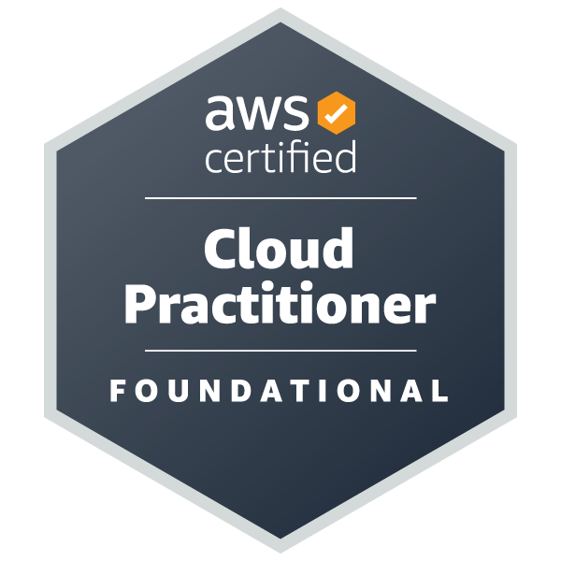
AWS Cloud Practitioner Exam
• Exam is 90 minutes long
• consists of 65 questions
• 700 out of 1000 to pass
• Domain 1: Cloud Concepts (24% of scored content)
• Domain 2: Security and Compliance (30% of scored content)
• Domain 3: Cloud Technology and Services (34% of scored content)
• Domain 4: Billing, Pricing, and Support (12% of scored content)

Slide 17
How to study for AWS Certifications
Stephane Mareek on Udemy has a great course for the AWS certification
Practice exams
Chatgpt

Slide 18
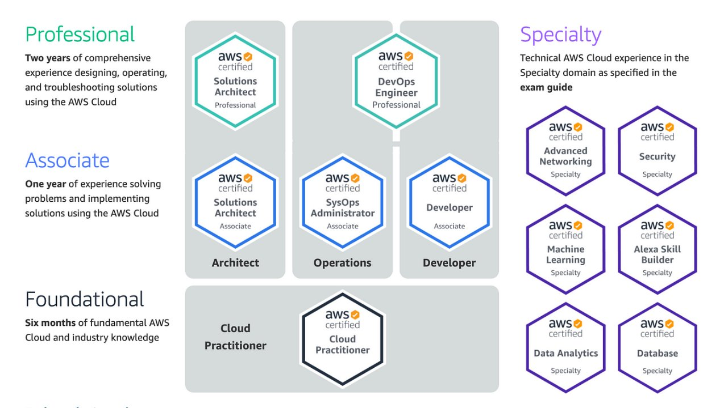
Other AWS Exams

Slide 19
Why should you get Microsoft Azure Certifications?
Shows employers you can manage and deploy cloud solutions using one of the fastest-growing cloud platforms.
Helps you stand out for roles in cloud engineering and security.
Increases your earning potential and opens doors to Microsoft-based enterprise environments.

Slide 20
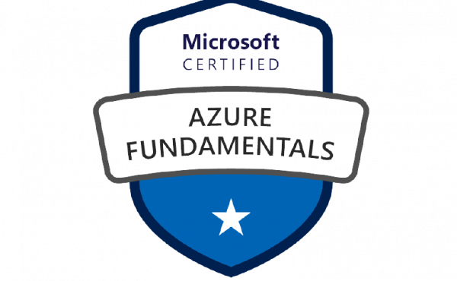
Microsoft Certified: Azure Fundamentals (AZ-900)
Describe cloud concepts (25–30%)
Describe Azure architecture and services (35–40%)
Describe Azure management and governance (30–35%)

Slide 21
How to study for Microsoft Azure Certifications
Youtube videos
Microsoft learn
Chatgpt

Slide 22
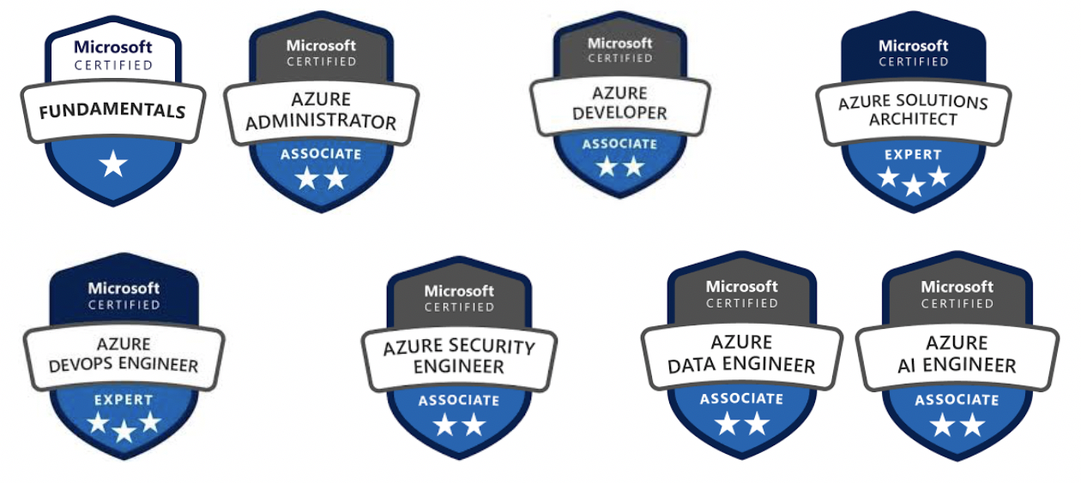
Other Azure Exams

Slide 23
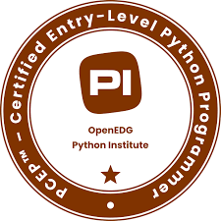
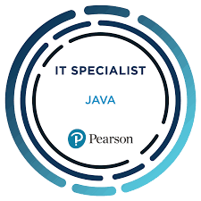
Coding language Certifications
Not worth getting
Better to just focus on projects
Recruiters don’t really care about it

Slide 24
Conclusion
Study Materials
Chatgpt
Practice exams
Youtube
Professor messer
Udemy
Vendor learning programs
Comptia Certifications
Most widely recognized
Most seeked by jobs
A+, Net+, Sec+
Recommended to skip A+
Cloud Computing Certifications
Practice exams
Vendor learning programs

Slide 25

Follow Us
Discord
LinkedIn
Instagram
Bulls Connect
GitHub

Slide 26
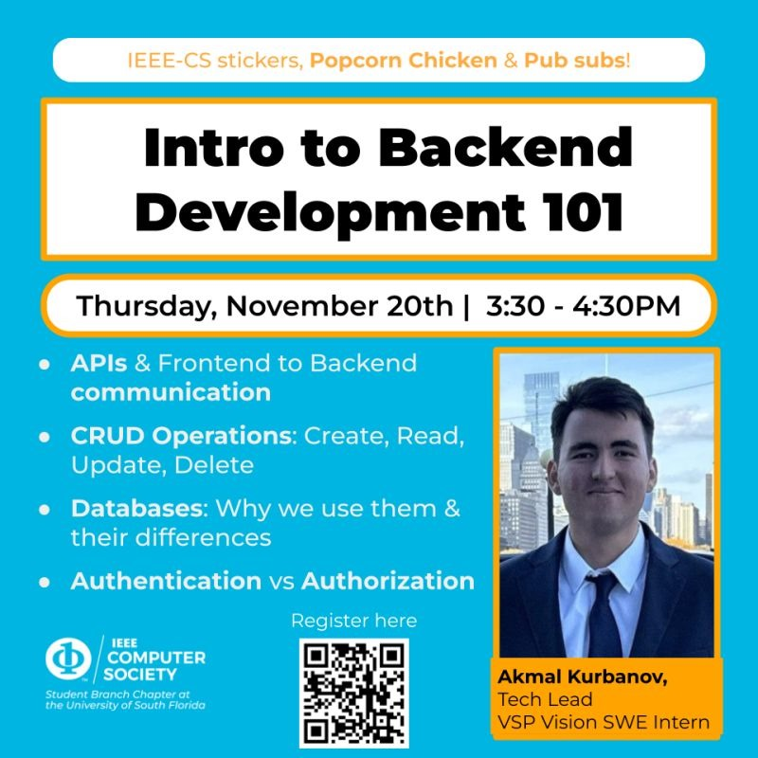
COME TO OUR NEXT EVENT!

